Slide 1
Logic Gates
Based on “The Elements of Computing Systems”, Nisan & Schocken, MIT Press, forthcoming in 2004, www.idc.ac.il/tecs
project 8
Yana Gabelev

Slide 2
Links
Project 8:
http://my.jce.ac.il/~arikgi/Web/Ex/Ex08/index.htm
EX08 zip :
http://my.jce.ac.il/~arikgi/Web/Ex/Ex08/Ex08.zip

Slide 3
HDL (Hardware Description Language)
Formalism for defining and testing chips:
objects whose interfaces consist of input and output pins that carry Boolean signals, and whose bodies are composed of inter-connected collections of other, lower level, chips.
/** Checks whether two 3-bit input buses are equal */
CHIP EQ3 {
IN a[3], b[3];
OUT out; // True if a=b
PARTS:
Xor(a=a[0], b=b[0], out=c0);
Xor(a=a[1], b=b[1], out=c1);
Xor(a=a[2], b=b[2], out=c2);
Or(a=c0, b=c1, out=c01);
Or(a=c01, b=c2, out=neq);
Not(in=neq, out=out);
}
Notes:
ב-HDL אין חשיבות לסדר השורות

Slide 4
Chip Header
CHIP <chip name> {
IN <input pin name>, <input pin name>, ... ;
OUT <output pin name>, <output pin name>, ... ;
// Here comes the body.
}
CHIP declaration: The CHIP keyword is followed by the chip name. The rest of the HDL code appears between curly brackets.
Input pins: The IN keyword is followed by a comma-separated list of input pin names. The list is terminated with a semi-colon.
Output pins: The OUT keyword is followed by a comma-separated list of output pin names. The list is terminated with a semi-colon.

Slide 5
Chip Body
<internal chip part>:
<connection>:
PARTS:
<internal chip part>;
<internal chip part>;
. . .
<internal chip part>;
<chip name>(<connection>, ... , <connection>);
<part's pin name> = <chip's pin name>

Slide 6
Pins and Connections
Internal pins: In order to connect an output pin of one part the input pins of other parts.
Each Input pin of a part may be fed by one of the following sources:
An input pin of the chip;
An internal pin;
Constants true and false, representing 1 and 0, respectively.
Each Output pin of a part may feed one of the following destinations:
An output pin of the chip;
An internal pin.
Part1(..., out=v); // out of Part1 is piped into v
Part2(in=v, ...); // v is piped into in of Part2
Part3(a=v, b=v,...); // v is piped into both a and b of Part3

Slide 7
Buses
Each pin used in a connection (whether input, output, or internal) may be a multi-bit bus.
In order to connect individual elements of a multi-bit bus input or output pin: x[i] or x[i..j]=v, where v is an internal pin.
An internal pin (like v above) may not be subscripted.
The constants true and false may also be used as buses.
Example:
CHIP Foo {
IN in[8] // 8-bit input
OUT out[8] // 8-bit output
// Foo’s body (irrelevant to the example)
}

Slide 8
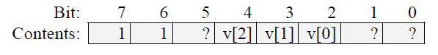
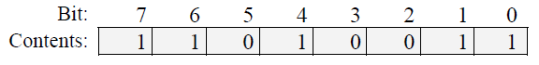
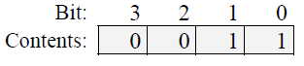
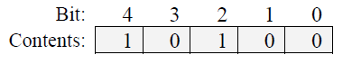
Foo is invoked by another chip using the part statement:
In that case, the connections in[2..4]=v and in[6..7]=true will bind the in bus of the Foo chip to the following values:
in:
Let us assume that given this input, the logic of the Foo chip returns the following output:
out:
In that case, the connections out[0..3]=x and out[2..6]=y will yield:
x: y:
Foo(in[2..4]=v, in[6..7]=true, out[0..3]=x, out[2..6]=y)

Slide 9
Implementation
Implement all the following logic gates:
Not | Not16 |  |  | B (twist)
And | And16
Or | Or16 |  | Or8way
Xor
Mux | Mux16 | Mux4way16 | Mux8way16
DMux |  | DMux4way | DMux8way

Slide 10
The Nand gate (built in)
a b out
0 0 1
0 1 1
1 0 1
1 1 0
Chip name: Nand
Inputs: a, b
Outputs: out
Function: If a=b=1 then out=0 else out=1
Comment: This gate is considered primitive and thus there is no need to implement it.

Slide 11
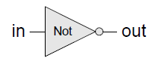
The Not gate
in out
0 1
1 0
Chip name: Not
Inputs: in
Outputs: out
Function: If in=0 then out=1 else out=0.
Not(a) = Nand(a, a)

Slide 12
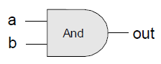
The And gate
a b out
0 0 0
0 1 0
1 0 0
1 1 1
Chip name: And
Inputs: a, b
Outputs: out
Function: If a=b=1 then out=1 else out=0.
And(a, b) = Not( Nand(a, b))

Slide 13
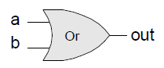
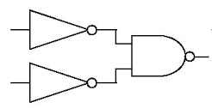
The Or gate
a b out
0 0 0
0 1 1
1 0 1
1 1 1
Chip name: Or
Inputs: a, b
Outputs: out
Function: If a=b=0 then out=0 else out=1.
Or(a, b) = Not(And(Not(a), Not(b)))
Notes:
Or(a, b) = Nand(Not(a), Not(b)))

Slide 14
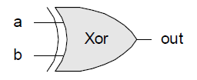
The Xor gate
a b out
0 0 0
0 1 1
1 0 1
1 1 0
Chip name: Xor
Inputs: a, b
Outputs: out
Function: If a≠b then out=1 else out=0.
Xor(a, b) = Or(And(a, Not(b)), And(Not(a), b)))

Slide 15
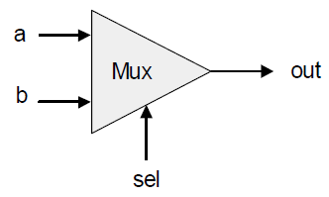
The Multiplexor (Mux)
a b sel out
0 0 0 0
0 0 1 0
0 1 0 0
0 1 1 1
1 0 0 1
1 0 1 0
1 1 0 1
1 1 1 1
sel out
0 a
1 b
Chip name: Mux
Inputs: a, b, sel
Outputs: out
Function: If sel=0 then out=a else out=b.
Notes:
out = Or(And(a, sel), And(b, Not(sel)))

Slide 16
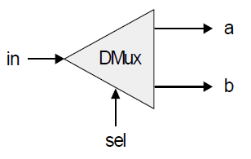
The Demultiplexor (DMux)
in sel a b
0 0 0 0
0 1 0 0
1 0 1 0
1 1 0 1
sel a b
0 in 0
1 0 in
Chip name: DMux
Inputs: in, sel
Outputs: a, b
Function: If sel=0 then {a=in, b=0} else {a=0, b=in}.
Notes:
a = And(in, Not(sel))
b = And(in, sel)

Slide 17
Multi-bit versions of basic gates
Multi-bit Not
Multi-bit And
Chip name: Not16
Inputs: in[16] // a 16-bit pin
Outputs: out[16]
Function: For i=0..15 out[i]=Not(in[i]).
Chip name: And16
Inputs: a[16], b[16]
Outputs: out[16]
Function: For I=0..15 out[i]=And(a[i],b[i]).

Slide 18
Multi-bit versions of basic gates
Multi-bit Or
Multi-bit Mux
Chip name: Or16
Inputs: a[16], b[16]
Outputs: out[16]
Function: For I=0..15 out[i]=Or(a[i],b[i]).
Chip name: Mux16
Inputs: a[16], b[16], sel
Outputs: out[16]
Function: If sel=0 then for i=0..15 out[i]=a[i] else for i=0..15 out[i]=b[i].

Slide 19
Multi-Way Versions of Basic Gates
Multi-way Or
An n-way Or gate outputs 1 when at least one of its bit inputs is 1, and 0 otherwise.
Chip name: Or8Way
Inputs: in[8]
Outputs: out
Function: out = Or(in[0], in[1], ..., in[7]).

Slide 20
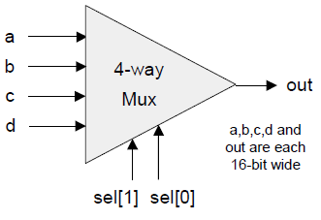
Multi-Way Versions of Basic Gates
Multi-way/Multi-Bit Mux
An m-way n-bit multiplexor selects one of m n-bit input busses and outputs it to a single n-bit output bus.
sel[1] sel[0] out
0 0 a
0 1 b
1 0 c
1 1 d
Notes:
An n-way Or gate outputs 1 when at least one of its bit inputs is 1, and 0 otherwise.

Slide 21
Chip name: Mux4Way16
Inputs: a[16], b[16], c[16], d[16], sel[2]
Outputs: out[16]
Function: If sel=00 then out=a else if sel=01 then out=b else
if sel=10 then out=c else if sel=11 then out=d
Comment: The assignment operations mentioned above are all 16-bit. For example, "out=a" means "for i=0..15 out[i]=a[i]".
Chip name: Mux8Way16
Inputs: a[16],b[16],c[16],d[16],e[16],f[16],g[16],h[16],sel[3]
Outputs: out[16]
Function: If sel=000 then out=a else if sel=001 then out=b else if sel=010 out=c ... else if sel=111 then out=h
Comment: The assignment operations mentioned above are all 16-bit. For example, "out=a" means "for i=0..15 out[i]=a[i]".

Slide 22
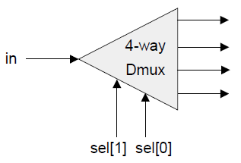
Multi-Way Versions of Basic Gates
Multi-way/Multi-Bit DMux
An m-way n-bit demultiplexor channels a single n-bit input into one of m possible n-bit outputs.
sel[1] sel[0] a b c d
0 0 in 0 0 0
0 1 0 in 0 0
1 0 0 0 in 0
1 1 0 0 0 in
Notes:
An n-way Or gate outputs 1 when at least one of its bit inputs is 1, and 0 otherwise.

Slide 23
Chip name: DMux4Way
Inputs: in, sel[2]
Outputs: a, b, c, d
Function: If sel=00 then {a=in, b=c=d=0}
else if sel=01 then {b=in, a=c=d=0}
else if sel=10 then {c=in, a=b=d=0}
else if sel=11 then {d=in, a=b=c=0}.
Chip name: DMux8Way
Inputs: in, sel[3]
Outputs: a, b, c, d, e, f, g, h
Function: If sel=000 then {a=in, b=c=d=e=f=g=h=0}
else if sel=001 then {b=in, a=c=d=e=f=g=h=0}
else if sel=010 ...
...
else if sel=111 then {h=in, a=b=c=d=e=f=g=0}.

Slide 24
Twist
Chip name: B
Inputs: a, b
Outputs: out
Function: out = b.

Slide 25
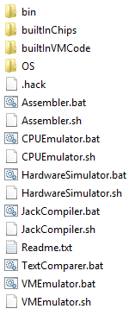
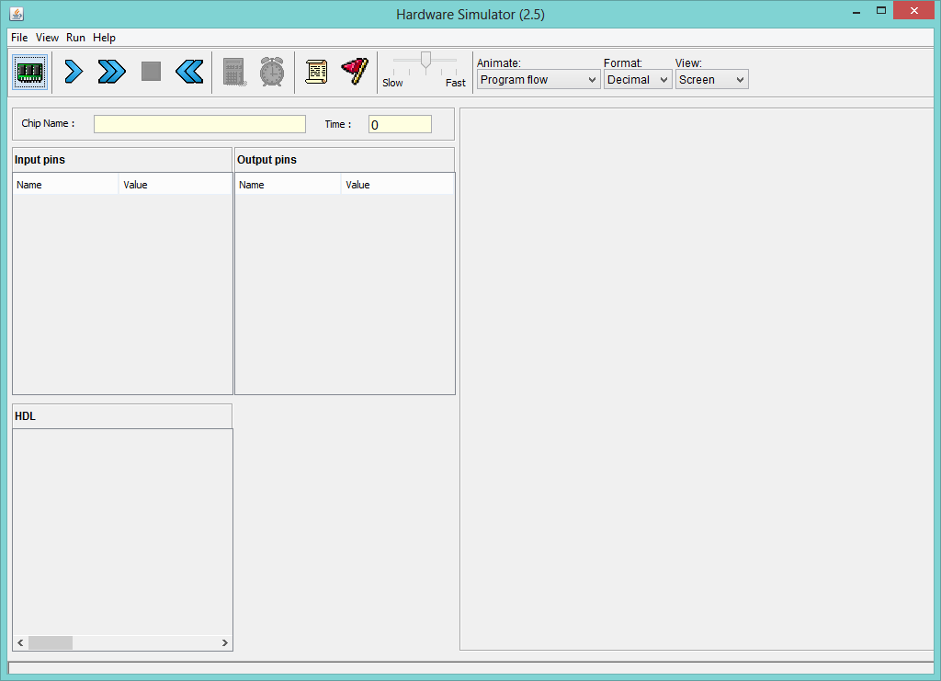

Slide 26
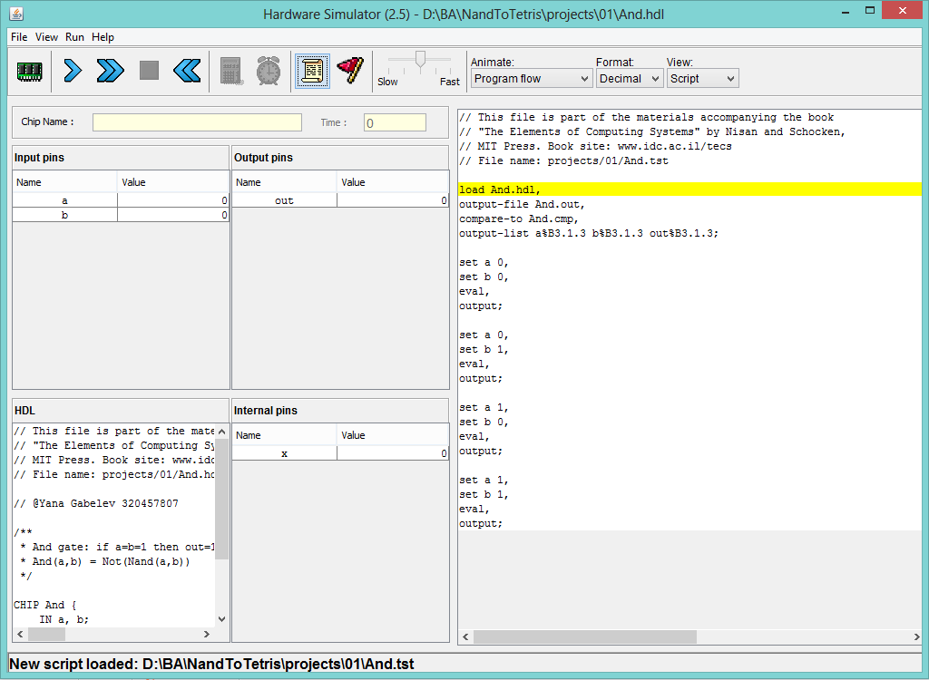
Load Xxx.hdl
Load Xxx.tst
run

Slide 27
How and what to submit
Create a folder named 2015B_exXX_YYYYYYYY, when XX is the ex number, and YYYYYYYY is your ID.
For example: 2015B_ex08_123456789
All submission files should be in that folder, and no other extra file. Files to submit: HDL files, README.txt
Zip the folder to a zip file named 2015B_exXX_YYYYYYYY.zip

Slide 28
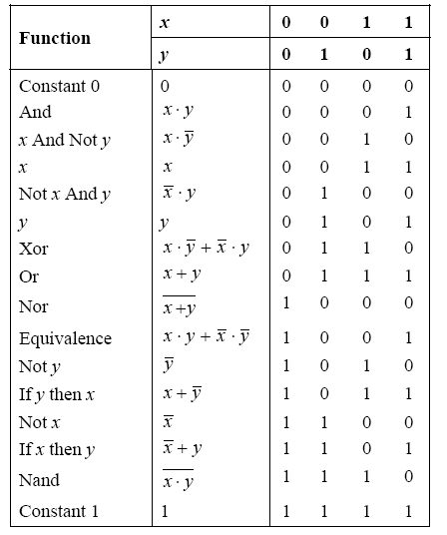
פונקציות בוליאניות הם הבסיס ליכולת החישוב המודרנית. בטבלה ניתן לראות את כל הפ"ב האפשריות של שני משתנים, מיוצגות ע"י טבלאות אמת וגם בעזרת תת הפונקציות (true [1] , false [0], and, or, not) למעשה, מספיקה פונקציה אחת ע"מ לבנות את שאר הפונקציות – הפונקציה nand
פונקציות בוליאניות

Slide 29
שערים לוגיים הם מימוש פיזי של פונקציות בוליאניות ומהווים בסיס לבניית מעגלים דיגיטליים מודרניים. שערים לוגיים בנויים מחומרים מוליכים למחצה (טרנזיסטורים) ונבנים בצורה תעשייתית בצורה אוטומטית . התכנון של השערים הלוגיים ממומש ע"י שפת HDL (Hardware Description Language)
שערים לוגיים

Slide 30
מבנה קובץ HDL
שם הקובץ
שם השבב
קלט
And.hdl
CHIP And
{ IN a, b;
OUT out;
PARTS:
bla bla bla bla
bla bla bla bla
}
פלט
שורה קבועה, אחריה מתחיל המימוש (שלכם)
מימוש בעזרת שערים לוגיים שבנינו כבר
את קבצי ה HDL בעזרת כל text editor למשל notepad

Slide 31
Logic Gate Construction
קודם כל איך מממשים את שער and בעזרת השערים nand (שער בסיס(
והשער not (שמימשנו קודם) ? שימו לב ש (and(a,b) = not(nand(a,b)
זאת אומרת שקודם כל נחשב את nand(a,b) ואת התוצאה נחשב עם שער not.
איך משתמשים בשער nand ?
קודם כל נכתוב את שער נאנד עם השקעים שלו : Nand(a=, b=, out= ) . צד שמאל של "משוואה" כזו הוא תמיד שקע וימין תמיד תקע
צעד הבא הוא לחבר את התקעים. נכניס את הקלט a,b של שער and ועוד תקע בשביל לשמור את תוצאת הביניים שנכנה אותו בשם out1.
(לא להתבלבל מכך שמשתמשים באותו הסימון כמו a לסמן חיבורים שונים, מה שקובע זה המיקום)
ונקבל Nand(a=a, b=b, out= out1). את התוצאה ששמרנו ב out1 נחבר לשער not באותה הצורה Not(in=out1,out=out) .

Slide 32
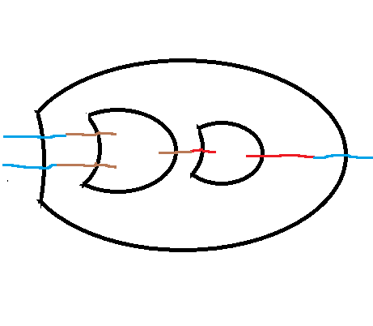
and
nand
not
a
a
out
out1
in
out
out
b
b
nand

Slide 33
מבנה קובץ HDL
שם הקובץ
שם השבב
קלט
And.hdl
CHIP And
{ IN a, b;
OUT out;
PARTS:
Nand(a=a, b=b, out=out1)
Not(in=out1,out=out)
}
פלט
שורה קבועה, אחריה מתחיל המימוש (שלכם)
מימוש בעזרת שערים לוגיים שבנינו כבר
לאחר שבנינו את הקובץ - איך מריצים ובודקים?

Slide 34

Download ZIP file

Slide 35
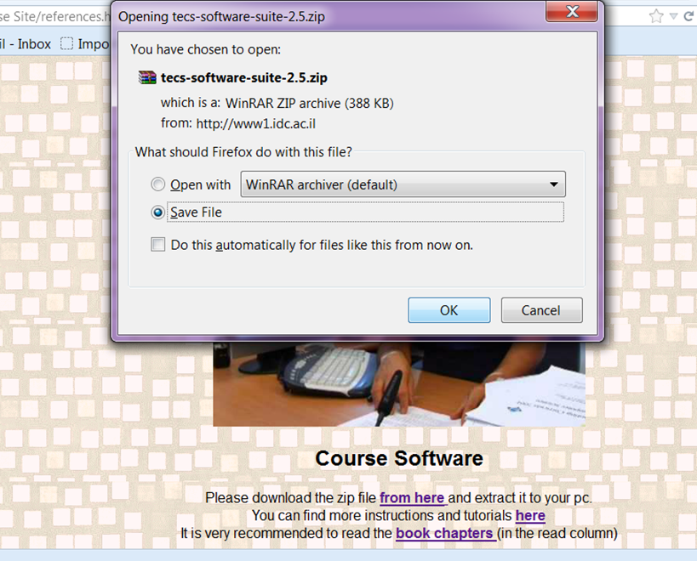
Download ZIP file

Slide 36
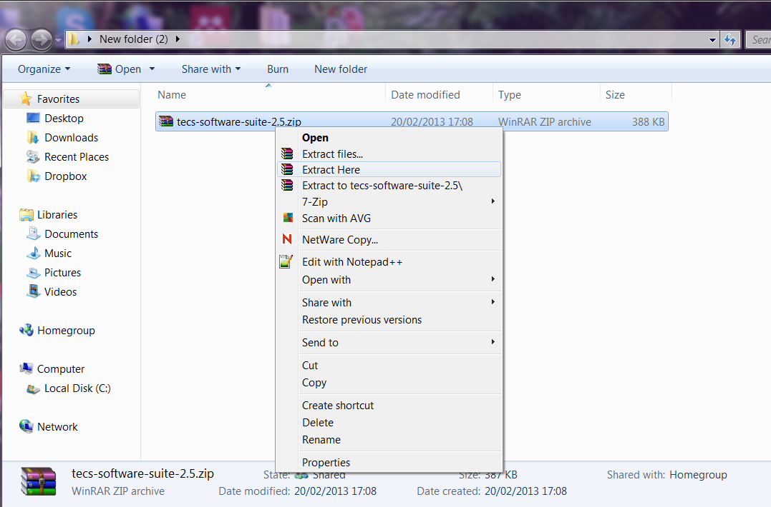
Extract Files

Slide 37
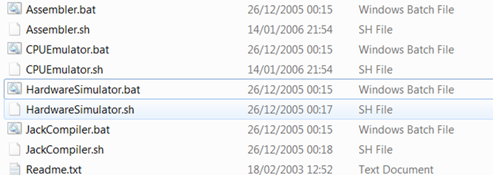
For windows
Execute Hardware Simulator
For linux

Slide 38
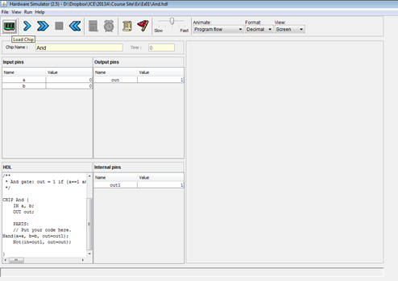
step1
Load your chip

Slide 39
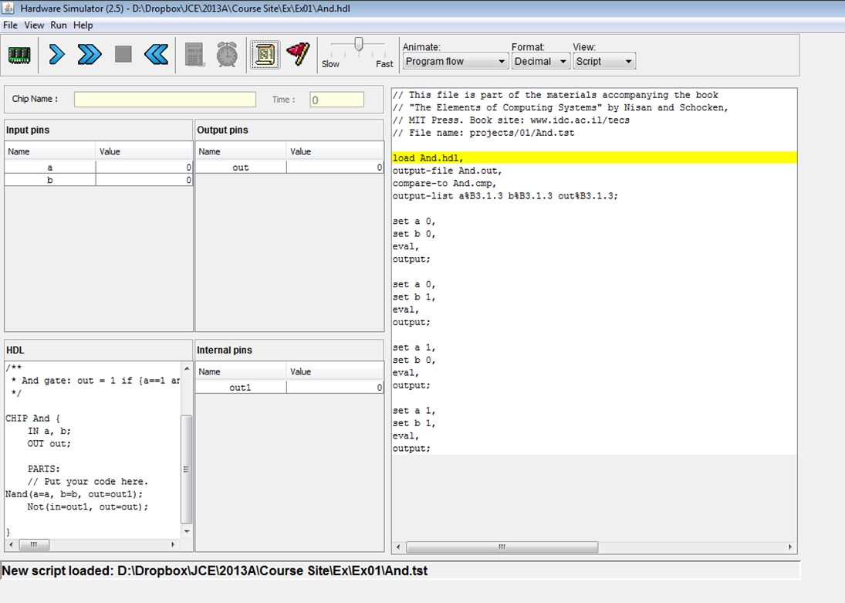
step2
Load test script

Slide 40
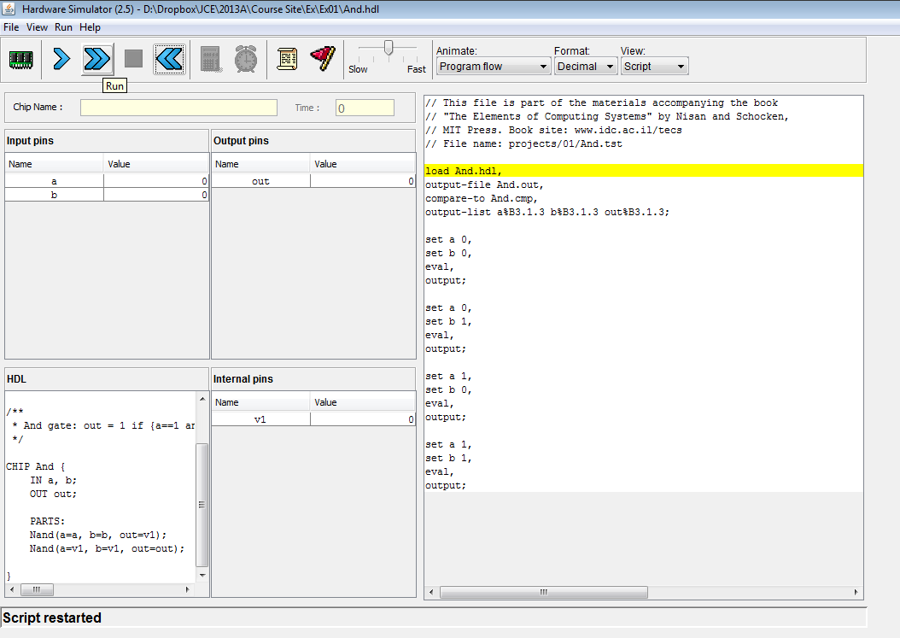
step3
run test script
If Everything is OK – you will see a message in black Comparison Successful.
If not, you will see an red error message

Slide 41
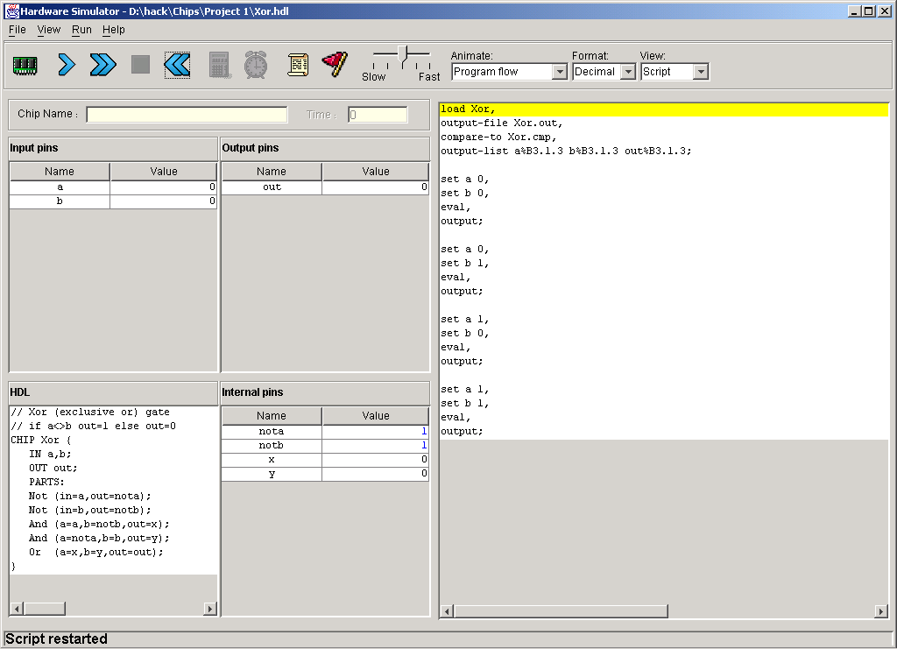
Hardware simulator (demonstrating Xor gate construction)
HDL program
test script

Slide 42
Hardware simulator
HDL program

Slide 43
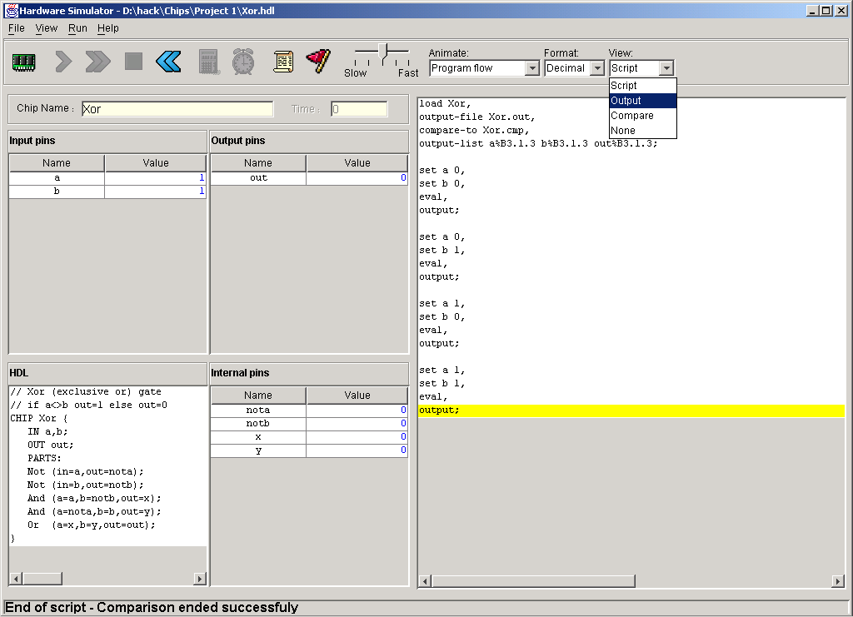
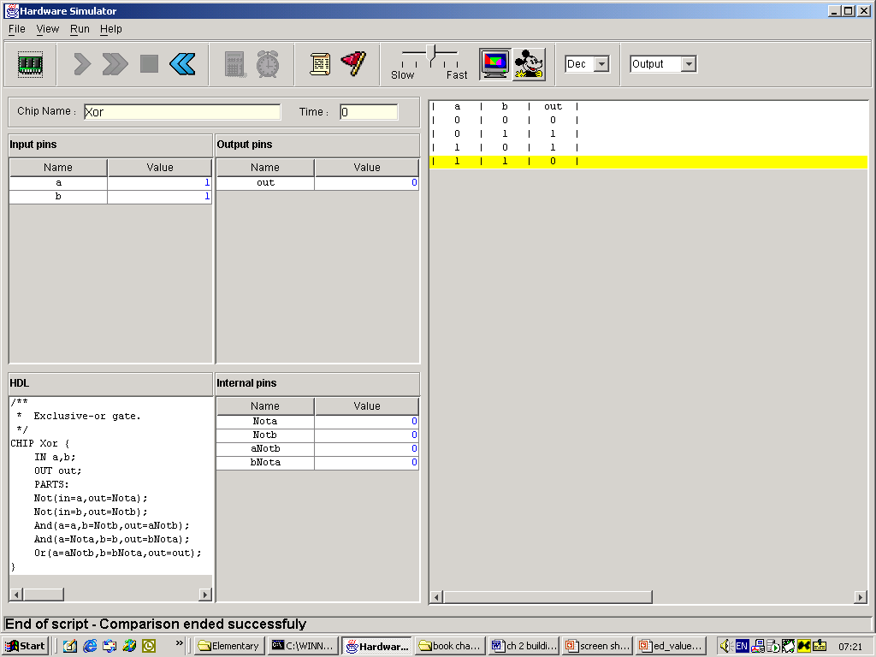
Hardware simulator
HDL program
output file

Slide 44
Useful Tips
The given HDL files are partial – they will not work. If you wish to build AND gate before NOT (and use not in the implementation), you need to do it in a separate folder, and then the simulator will use built in chips
If you don’t see the messages in the HW simulator, try stretching the window or hiding the task bar
Input/output can be an array. Usage : var[index]
You can do also things like a[1..10]=b[0..9] instead of writing 10 different lines
When representing a number in 16 bit, LSB will be in the 0 coordinate, while the MSB will be in the 15
Look at the .out files(output of your code) and .cmp files(required output), they are very understandable. This will help you debugging your code
Make sure you understand slides 32-33 perfectly before starting to write any code
The testers are very easy to construct, try to test additional cases (the grader will!!)

Slide 45
Multi-bit operations
sub bus of an internal node may not be used – we cannot split internal pins. That’s how the simulator works, and not a very logic choice. But that's life

